Slide 1
Chongqing University of Technology
ATAI
Advanced Technique of Artificial Intelligence
Artificial
ATAI
^{Chongqing} Advanced Technique
University of of Artificial
_{Technology} Intelligence
Chongqing ^{ATAI}
Advanced
University of _{logy Technique of}
Technology
Chongqing University of Technology
Chongqing University of Techno
Intelligence
Contrast and Generation Make BART a Good Dialogue Emotion Recognizer
https://github.com/whatissimondoing/CoG-BART.
—— AAAI 2022
2022.11.15 • ChongQing
Reported by Yuyang Lai
1

Slide 2
ATAI
ATAI
^{Chongqing} Advanced Technique
University of of Artificial
Intelligence
Chongqing University of Technology
Advanced Technique
of Artificial Intelligence

Slide 9
Chongqing University of Technology
ATAI
Advanced Technique of Artificial Intelligence
Chongqing University of Technology
CauAIN: Causal Aware Interaction Network for Emotion Recognition in
Conversations
Weixiang Zhao , Yanyan Zhao∗, Xin Lu
Harbin Institute of Technology, China
{wxzhao, yyzhao, xlu}@ir.hit.edu.cn
Code：https://github.com/circle-hit/CauAIN
2022.11.24 • ChongQing
—— IJCAI 2022
Reported by Renhui Luo

Slide 10
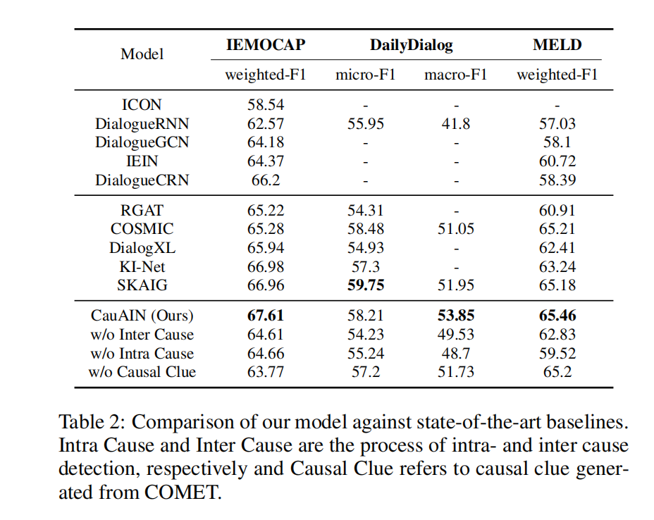
Experiments
Chongqing University of Technology
ATAI
Advanced Technique of Artificial Intelligence
Chongqing University of Technology
66.36 57.59 52.70 64.81

